Slide 1
STEM for Kiddos Pitch Video
Selik Samai

Slide 2
Team
Lead: Alexis Sloan
Grant and Ads Research: Selik Samai
Website: Avery Willets, Jade Herman, Chris Perme
Marketing: Maya Shackleford, David Lujan
Art: Daniel Shapiro, Braden Greenwall, Zyriyah Stoker, Dawson Katzer, Ty Murphy

Slide 3

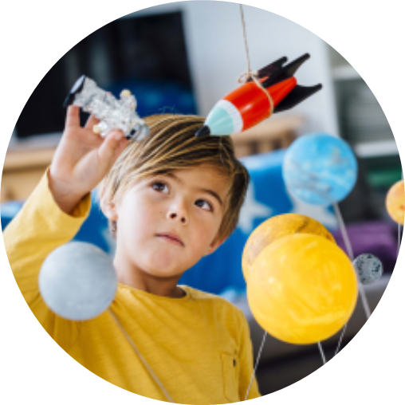
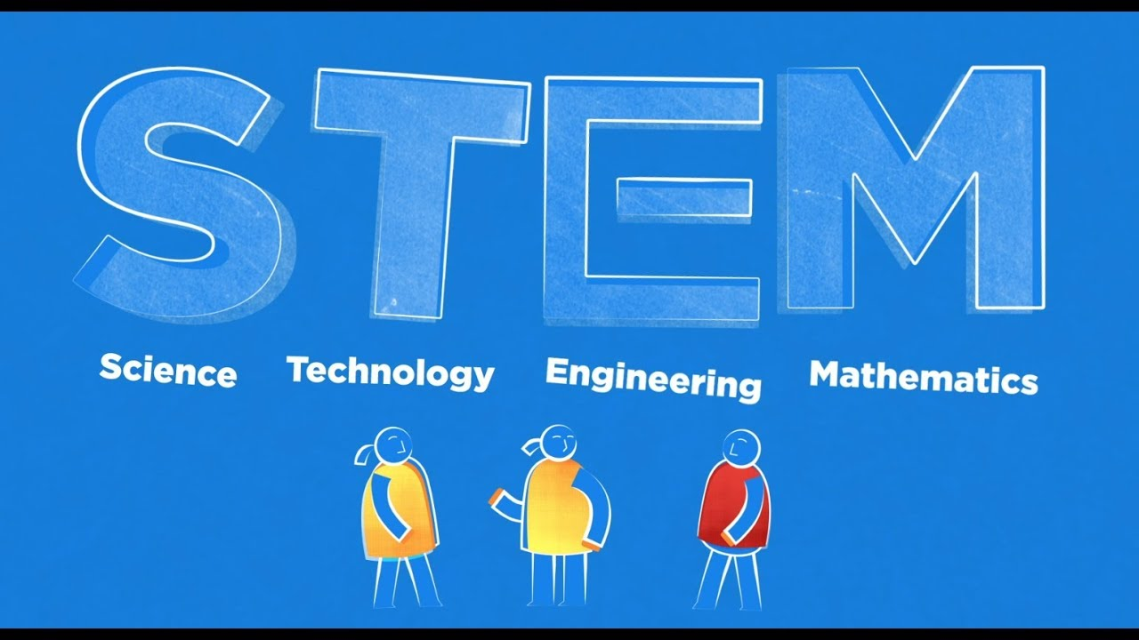
About STEM for Kiddos
STEM for Kiddos is a hands-on interactive learning box for kids ages 5-8 to learn about different topics with fun step-by-step projects that both the kids and parents can have fun with

Slide 4
Goals
Create a variety of boxes
Different themes
3d prints, boxes
Different age groups
Receive funding
Grants, subscriptions, single purchases
Marketing
Acquire Materials
Establish relationships and sponsorships with organizations
Start distributing in 2024.

Slide 5
Development Work
Pros
Cons
Agile approach
Adding new boxes/features steadily
Boxes grant variety amongst disciplines
Boxes have different themes
Boxes have different target age ranges
Ability to scale and manage
Model can be subscription based
Scrum approach to development
Opportunity for video development
Startup funding is difficult to gain
Target audience are ages 5-8 so customers usage won’t likely span beyond this time length
Need to find additional prospects and customers
Need to keep track of what box a customer has already purchased

Slide 6
Trello

Slide 7
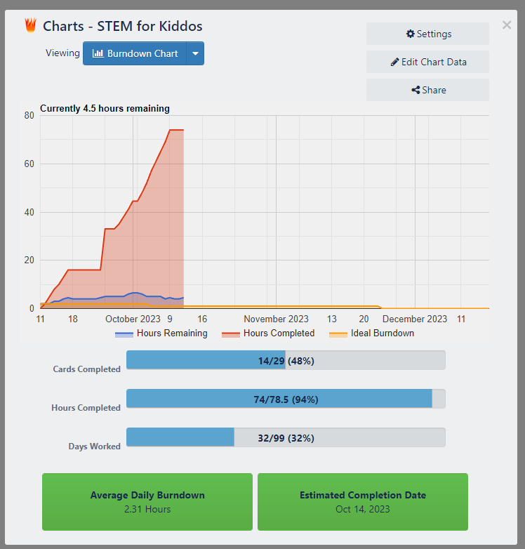
Burndown Chart
Trello along with the burndown chart allows us to share progress with certain stakeholders as well as internally with our team.

Slide 8
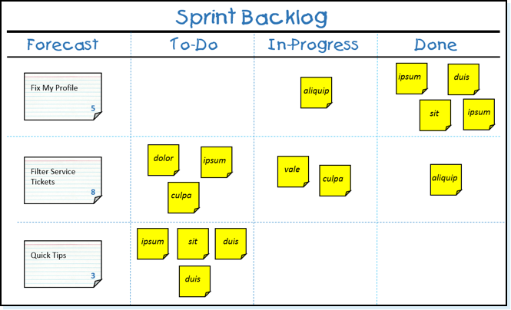
Backlog & Workflow
Allows for cross disciplinary work
Additional themes can be worked on by other teams simultaneously
Minimizes dead time where people are waiting for work.

Slide 9
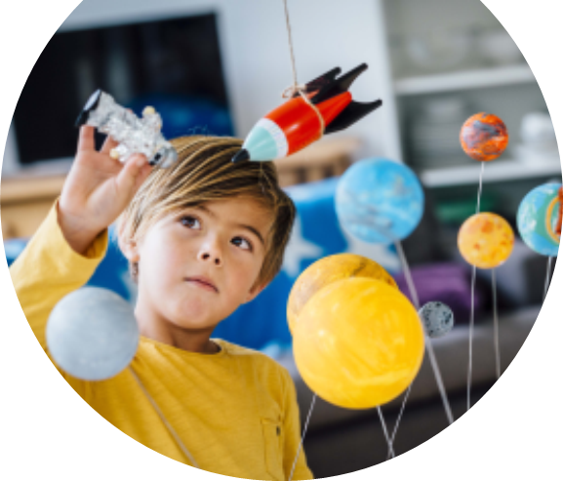
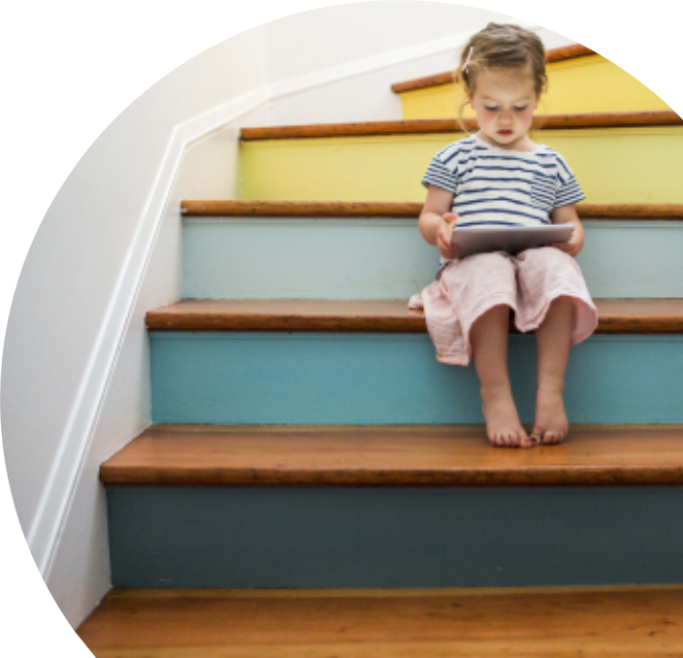
Summary
Stem for kiddos is the perfect way to help kids learn STEM in a new manner that can act as a foundation to any potential career in an amazing field.

Slide 10
Thank you
Presenter name
Email address
Links:
https://stem-for-kiddos-jade-test.webflow.io/
https://trello.com/b/cmits3CZ/stem-for-kiddos

